Slide 1
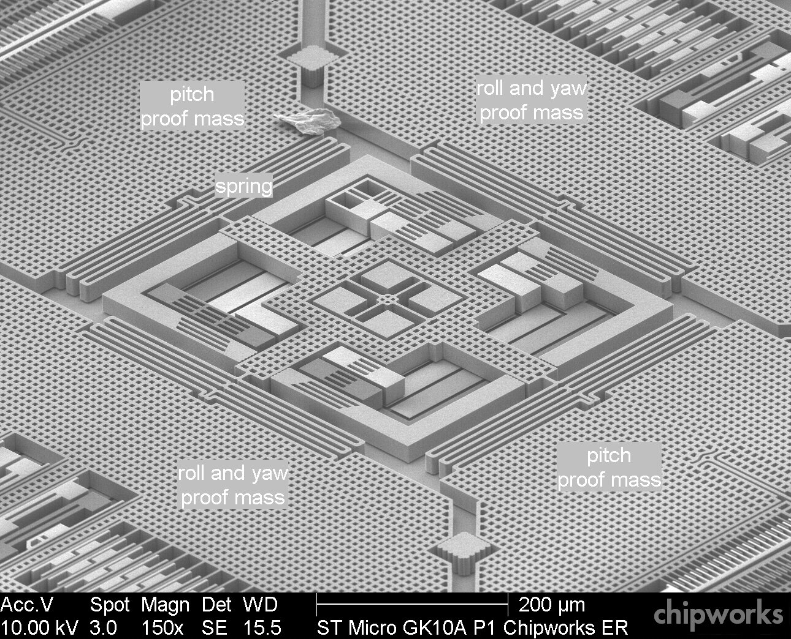
Sensors 2
KON-C2004 Mechatronics Basics
Raine Viitala 13.11.2024

Slide 2
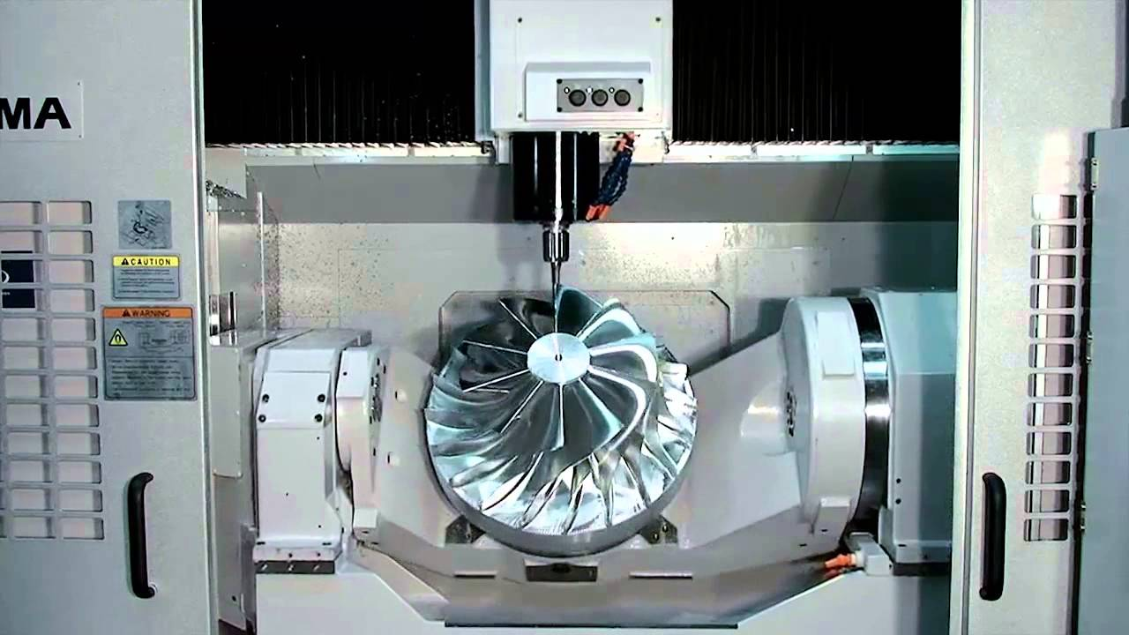
Mechatronic machine - subsystems
Controlling
computer
User Interface
Sensors
Signal
processing
Communication
(Bus, IoT, 5G)
Actuators
Controller
Affect and sense the physical world
Other systems and machines

Slide 3
Lecture topics & learning outcomes
Strain based sensors – force, torque, pressure
Magnetic sensors
Temperature sensors
Inertial sensors
Microelectromechanical systems
Sensor fusion etc.
-> Know the operating principle of multiple ”other sensor” types

Slide 4
Force & torque

Slide 5
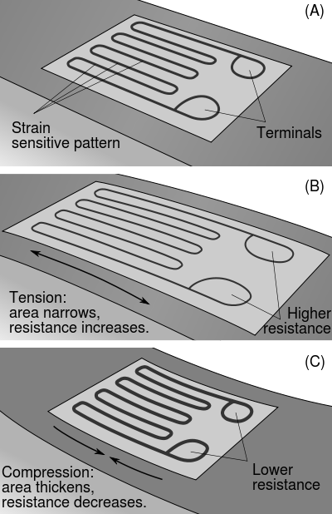
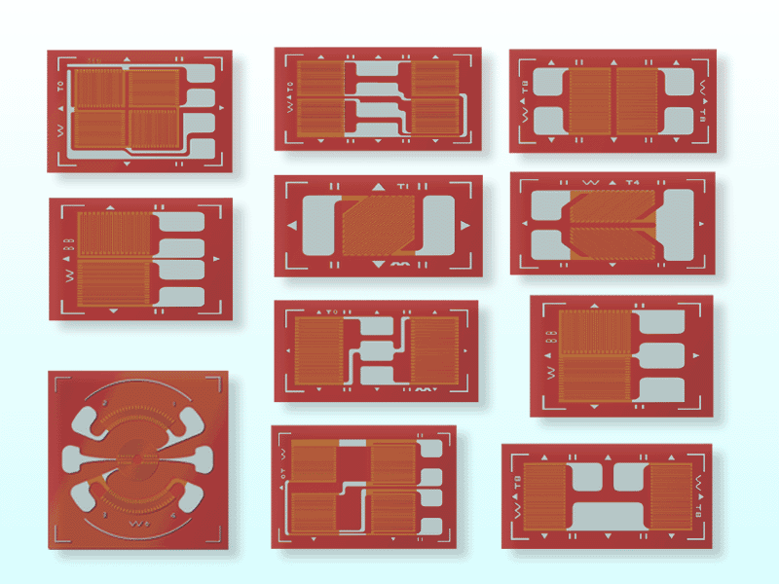
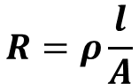
Strain gauge
http://en.wikipedia.org/wiki/Strain_gauge
Resistance changes when the gauge deforms
Result affected by temperature
$$R=ρ\frac{l}{A}$$
Notes:
Also spelled strain gage.
Consist of thin foil wires which get longer and narower as the strain gage is streched.
Tension in the material can be calculated from the strain. Hookes law: \sigma = E\epsilon. Stress = Young’s modulus*strain. Applies on elastic materials (in the elastic deformation region).
Usually very small elongation -> very small change in percents. Change in resistance 1/1000 to 1/million.
Usually resistance in 120 or 320 ohms.
Can be used as a displacement sensor for very small displacements.

Slide 6
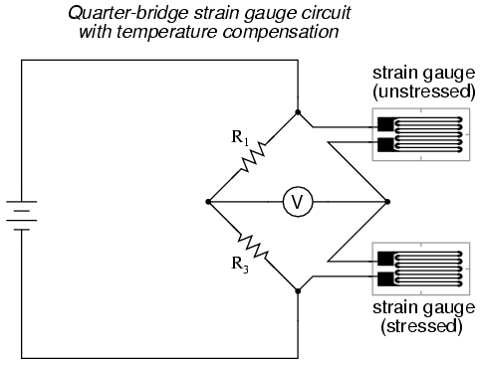
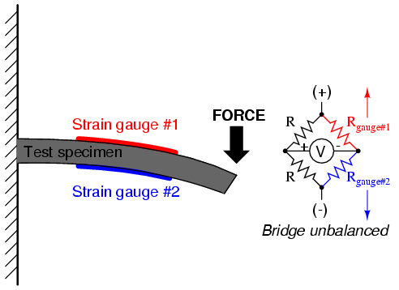
Wheatstone bridge for strain gauges
Zero centered, more sensitive output
Temperature compensating possible
http://www.allaboutcircuits.com/vol_1/chpt_9/7.html
http://www.allaboutcircuits.com/vol_1/chpt_9/7.html
Notes:
Removing zero offset.
In the image on the right, the upper strain gage is used only for temperature compensation. It is aligned so that it does not measure stress.
More sensitive when more active elements.
Piirrä vaikka taululle ulostulojännitteet ilman wheatstone bridgeä ja sen kanssa. Pelkällä jännitteenjaolla sillan yli jännite esim. 2.5-2.51 V. Sillan kanssa ulostuloamplitudi pieni, mutta nollakeskeinen, joten helppo vahvistaa.

Slide 7
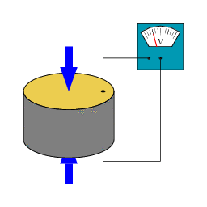
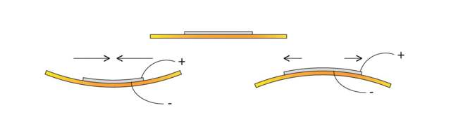
Piezoelectricity
http://en.wikipedia.org/wiki/Piezoelectricity
Piezo ~ "pressure," from Greek "to press tight, squeeze,"
Mechanical strain generates electric charge in material
Or charge generates strain
Very high dynamics
Sensors and actuators
Oscillators
Quartz clock
Microprocessors
http://upload.wikimedia.org/wikipedia/commons/thumb/3/3a/PiezoBendingPrinciple.gif/640px-PiezoBendingPrinciple.gif
Notes:
Required strain is extremely small -> stiff system -> high frequency response. Also very linear phenomenon.
Quartz oscillates at its natural frequency.
Works in both directions. Voltage -> strain and strain -> voltage.

Slide 8
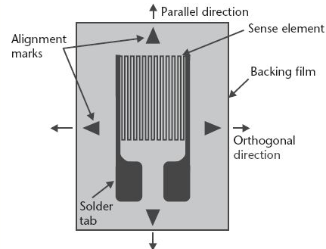
Piezoresistivity
Mechanical strain induces a change in semiconductor’s electrical resistivity
Highly temperature sensitive
Can be compensated for
Larger change than in normal strain gages
More sensitive sensors
Notes:
Piezoresistivity: Resistors which change resistance when force is applied on them.
Change in resistance is larger than with strain gages -> more sensitive sensors.

Slide 9
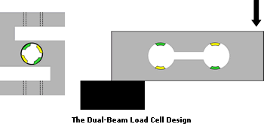
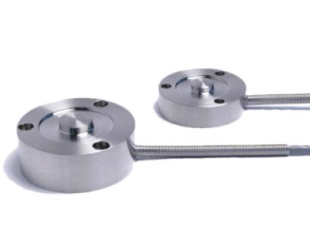
Force sensors (load cell)
Strain gauge
Measures deformation
Stable, linear
Piezoelectric load cells
High dynamics, very sensitive
Small size
Charge leaks -> measurement drifts
No static measurements
http://www.appmeas.co.uk/load-cells-and-force-sensors.html
Notes:
Piezoelectric, strain gauge, hydraulic
Strain gauge requies amplifier.
Piezoelectric requires charge amplifier.

Slide 10
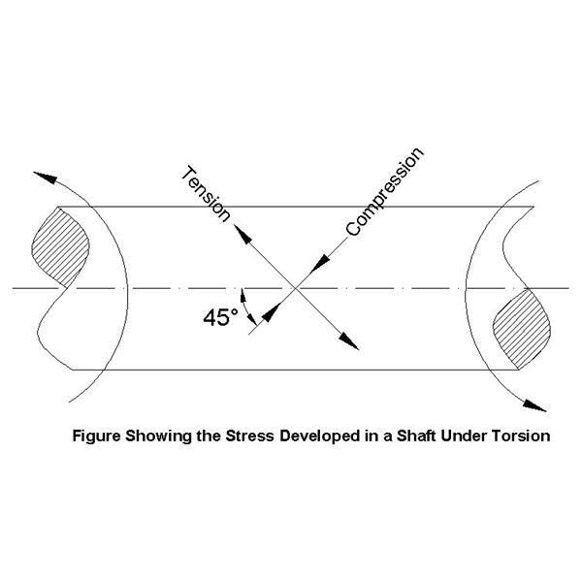
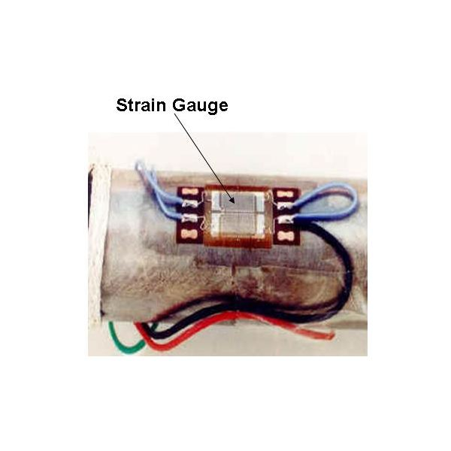
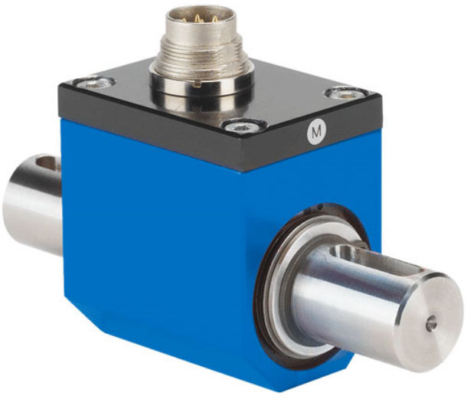
Torque sensors
Often strain gage based
Also encoder based measurement of axle torsion
http://www.brighthubengineering.com/machine-design/65871-how-to-measure-torque-requirements-for-gear-box/
Notes:
Since strain gauges are glued to rotating axis, the measured information can be difficult to transfer to a stationary device. Can be done with slip rings, transformers or nowadays with digital wireless networks.
Encoder based need to have a high resolution in order to measure accurately the very small displacement in the rotating angle of the shaft
SAW and magnetostrictive can be read wirelessly.

Slide 11
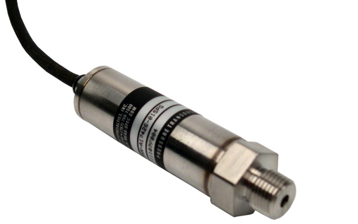
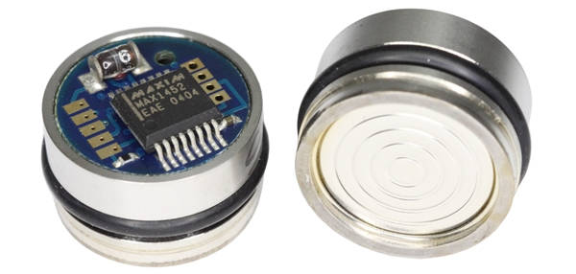
Pressure sensors
Piezoresistive
Most common
Piezoelectric
High dynamics. Drifting due to leakage.
Strain gauge
Capacitive
Notes:
Absolute pressure sensors, gauge pressure sensors, differential pressure sensors
Applications:
Hydraulics – pressure -> force
Atmospheric pressure – ventilation, altitude
Hydrostatic pressure – depth
Automotive – Oil, coolant, brake fluid, turbocharger
Medical – blood pressure

Slide 12
Hall effect

Slide 13
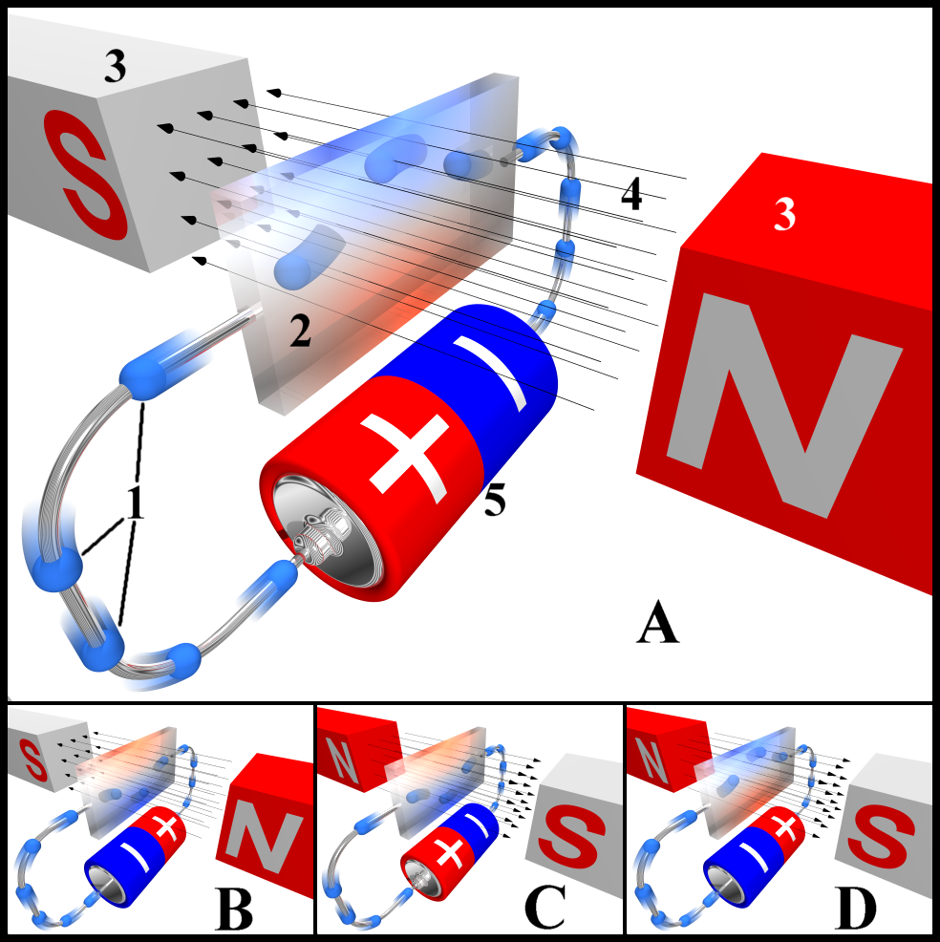
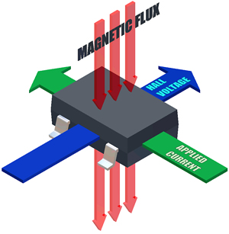
Hall effect
External magnetic field causes a voltage in the sensor
Current sensors
Magnetic field sensors
Very high dynamics
Robust sensors since no contact
Integrated into one chip
Notes:
Constant current is passed internally in the sensor through a semiconductor material. The external magnetic field deflects the path of the current which creates a small voltage perpendicular to the current.
The sensors can be sealed from the environment
Current sensor senses the magnetic field caused by current. No galvanic connection.

Slide 14
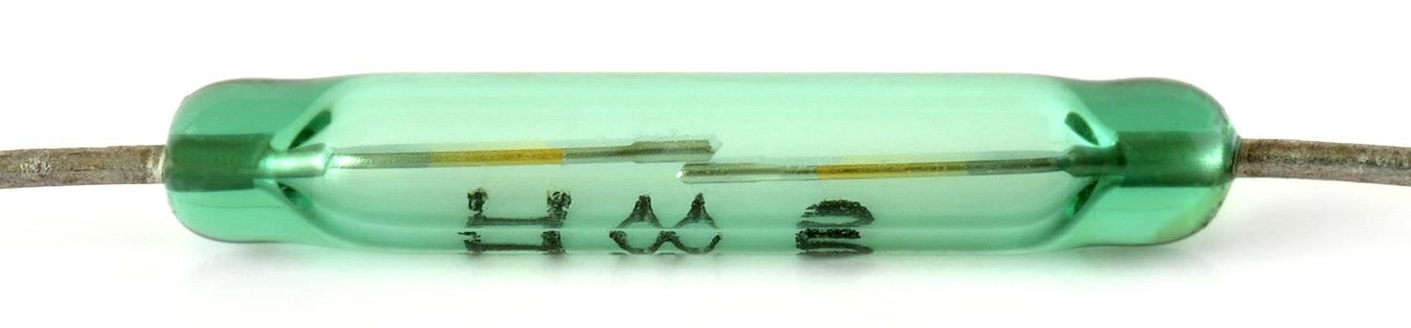
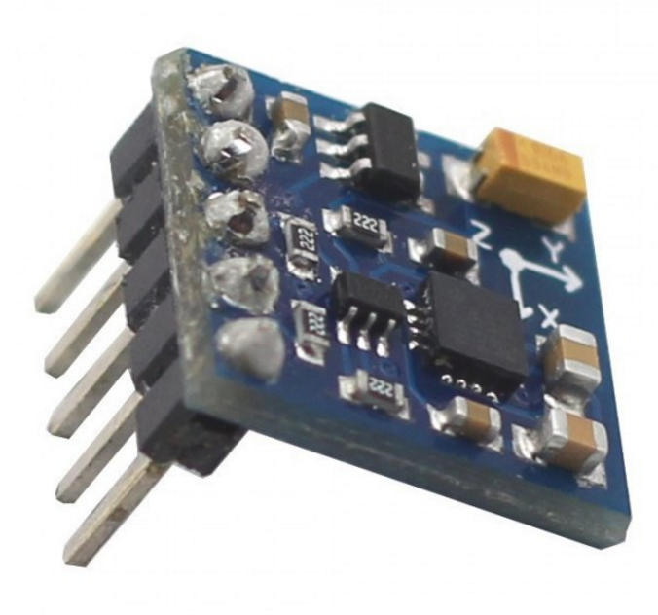
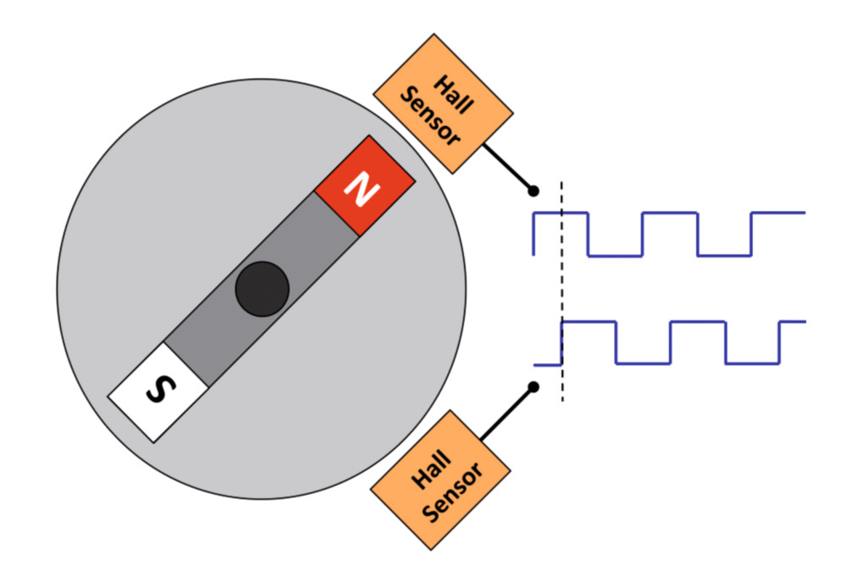
Magnetic sensors
Magnetic switch
Mechanical or electrical
Magnetic field intensity
On/off
Motor commutation
Magnetometer
Senses magnitude and direction of external magnetic field
Electric compass
Notes:
Position measuremets. A magnet induces a field which is sensed either as a proximity or continuous signal.
Mehcanical magnetic switch = Reed switch.
Electronic compass: for example Hall or magnetoresistive sensors perpendicular to each other. Can be used to measure earth’s magentic field.
Hall effect throttle?
Current sensors without galvanic contact
3-axis magnetometer 8 dollars.

Slide 15
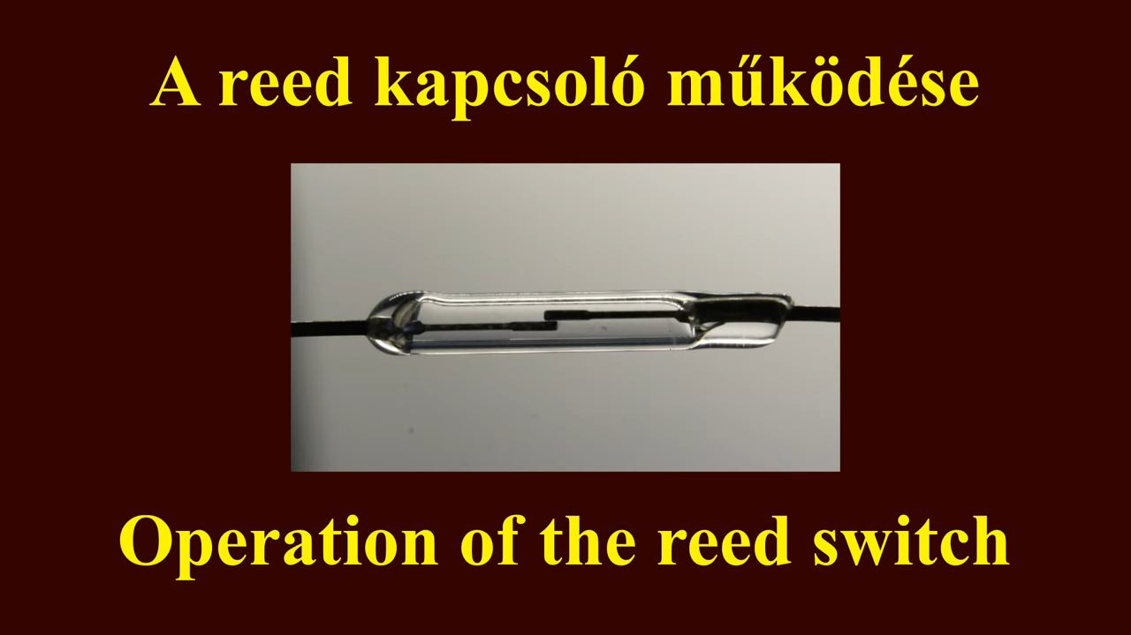

Slide 16
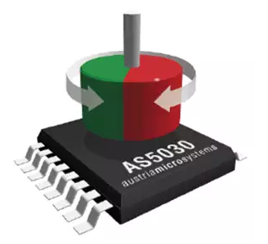
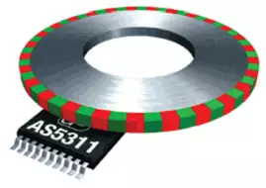
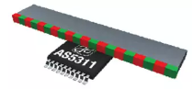
Magnetic encoders
Hall sensors sense the direction or the change of the magnetic field
E.g. gear tooth recognition
Notes:
More robust than optical.
Less resolution
Single magnet -> resolution 200ppr tsp?
Not absolute accuracy. Read the datasheet.

Slide 17
Temperature & imaging

Slide 18
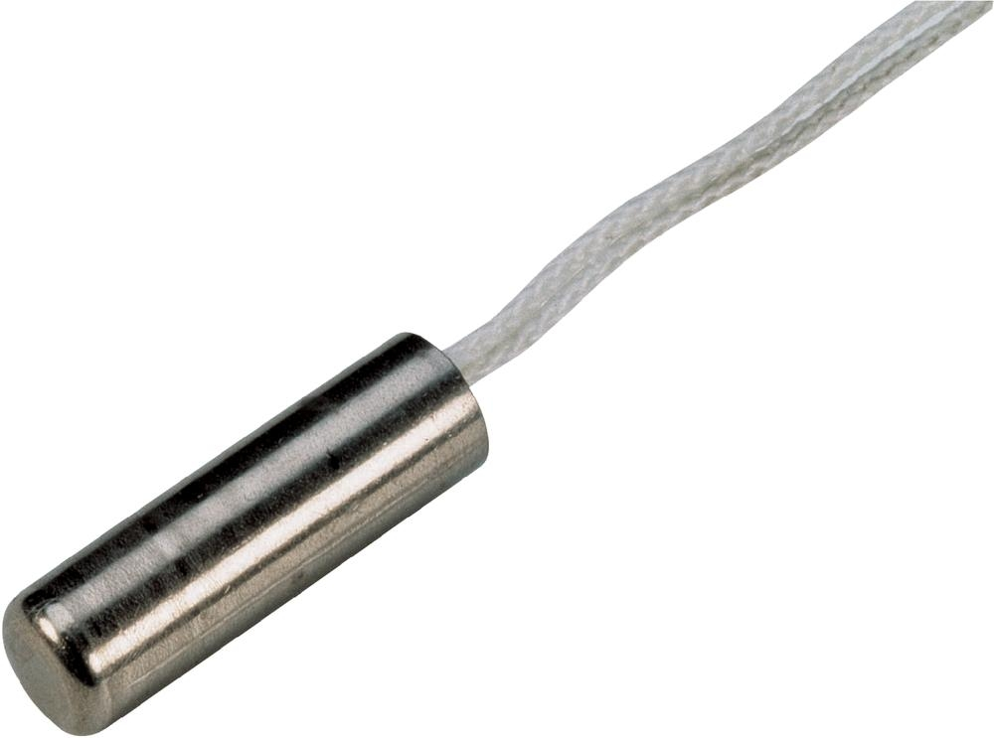
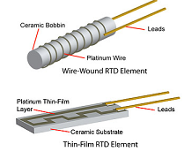
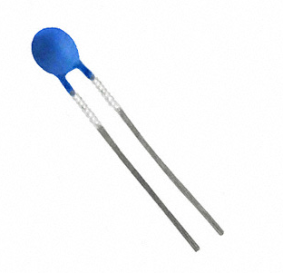
Temperature
Thermocouple
Change in voltage, a few µV per ̊ C
Temperature up to 2000 ̊ C, fast response
Resistance temperature sensor/detector (RTD)
Change in resistance (Pt100 100 ohm at 0 ̊ C )
High accuracy, linear response
Usually for temperatures below 600 ̊ C
Thermistor (NTC/PTC) (negative/positive temperature coefficient)
Semiconductor
Resistance changes. Exponential response -> limited range
Temperature up to 1700 ̊ C
http://sensorwiki.org/doku.php/sensors/temperature
Notes:
Thermocouple – thermoelectric effect. Self-powered. Any junction of different metals will produce a voltage depending on the temperature.
Pt 100 and other resistance temperature detectors are pure metals. Electrical resistivity of metals varies with temperature. Most accurate industrial sensors. Expensive.
Pt100 – resistance 100 ohms at 0 C°
Thermistors are resistors consisting of ceramics or polymer . Limited temperature range. Very cheap. Large change in resistance but nonlinear.
NTC = negative temperature coefficient, PTC = positive
Mass – response time
Accuracy vs. resolution

Slide 19
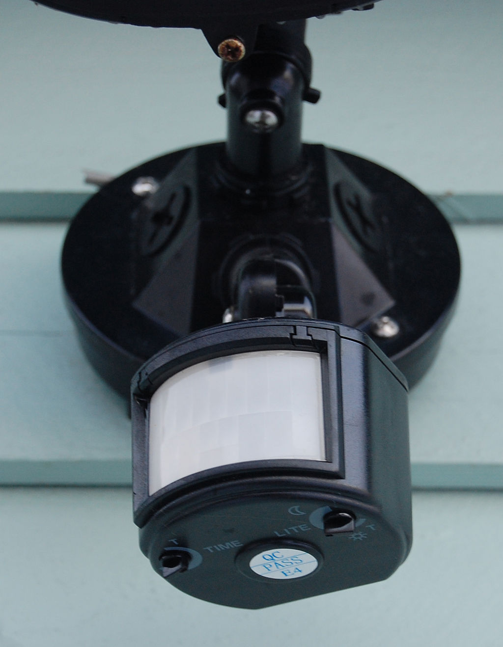
Pyroelectricity
Change in temperature (infrared radiation) causes voltage difference in certain materials
Application: Passive Infrared (PIR) motion sensors
https://en.wikipedia.org/wiki/Passive_infrared_sensor#/media/File:Motion_detector.jpg
Notes:
All objects emit infrared radiation i.e. heat.
Passive – the sensor does not radiate heat.
As presence sensors in building automation for controlling lightning, ventilation and heating

Slide 20
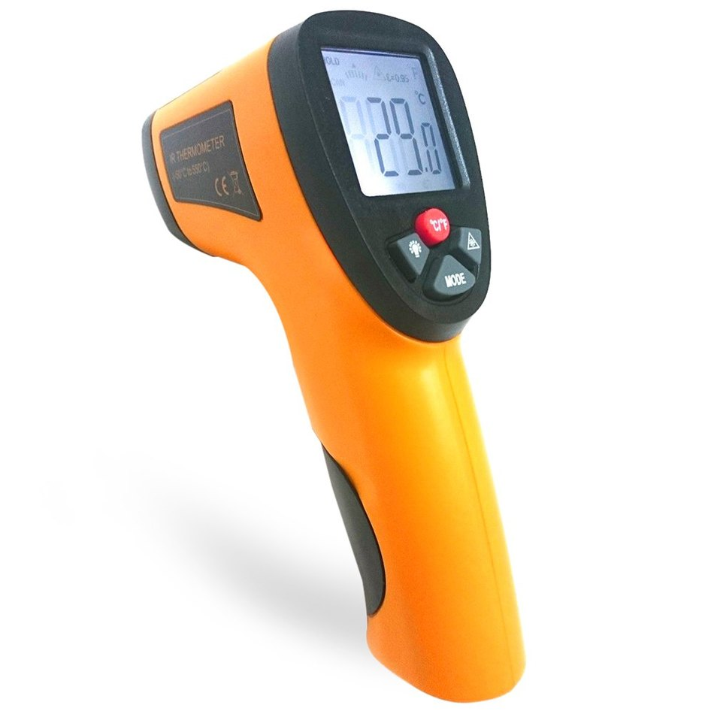
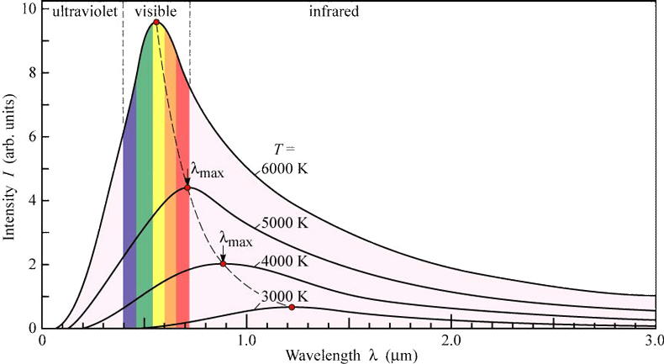
Contactless temperature measurement
All objects emit black body radiation
infrared ~ heat
Benefits from contactless sensing
Moving objects
Short response time
Temperatures over 1300°C
Notes:
Measurement does not interfere with the object. No energy loss through conduction.
Cannot measure inside containers. Only surface temperature
Emissivity i.e. surface’s ability to emit infrared radiation must be known.
Thermopile
http://support.fluke.com/raytek-sales/Download/Asset/IR_THEORY_55514_ENG_REVB_LR.PDF

Slide 21
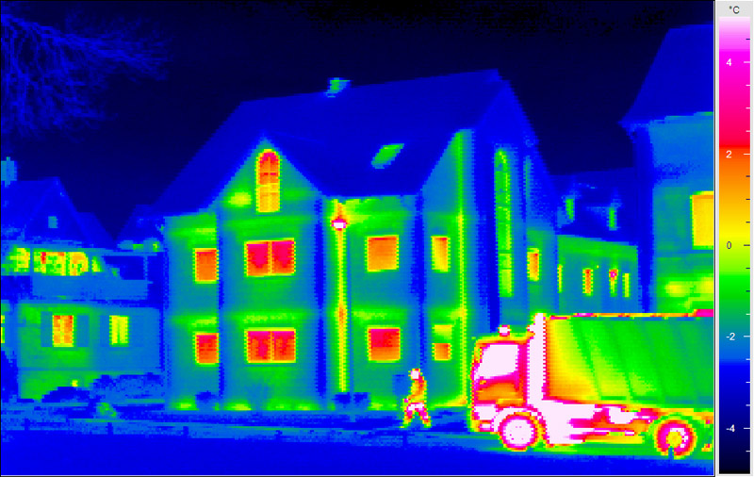
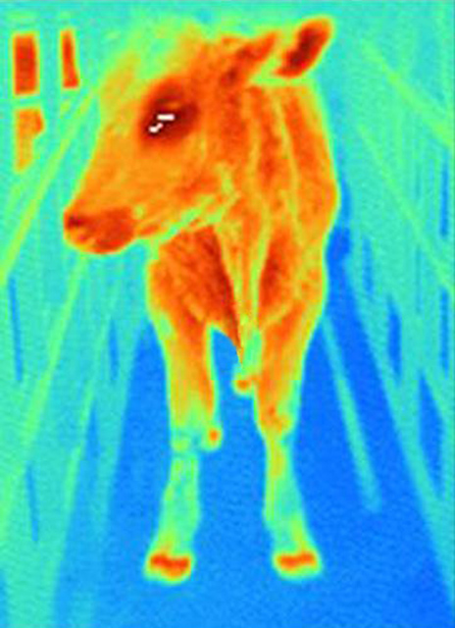
Thermal imaging
Notes:
And other frequencies outside the visible light spectrum
https://en.wikipedia.org/wiki/Thermography

Slide 22
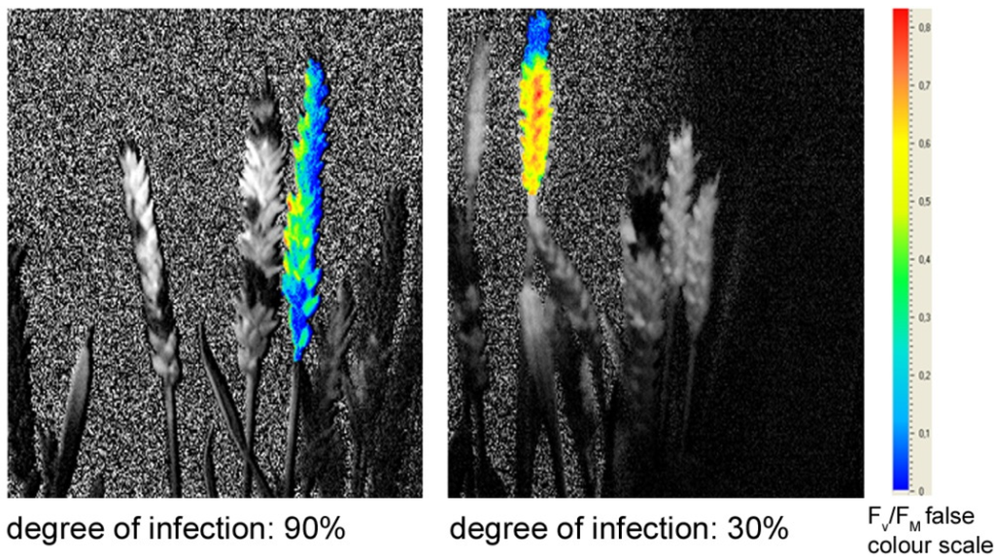
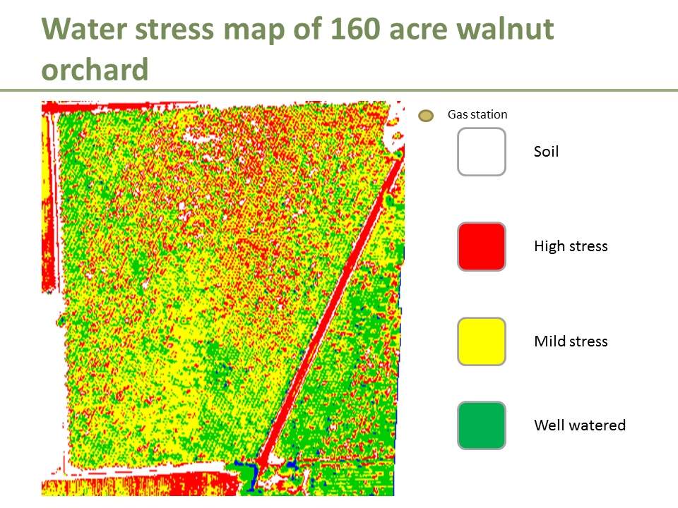
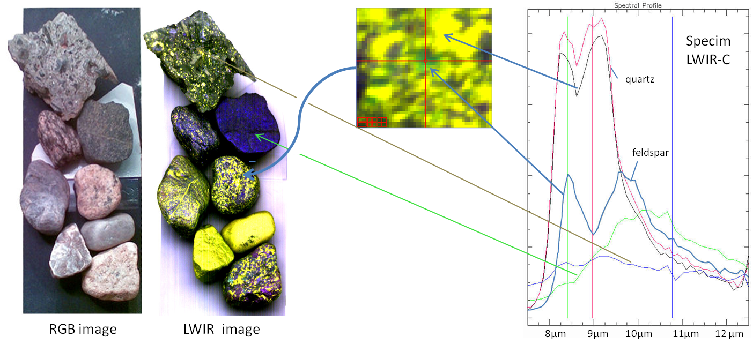
Hyperspectral imaging
https://en.wikipedia.org/wiki/Hyperspectral_imaging
https://hbr.org/2014/02/what-drones-and-crop-dusters-can-teach-about-minimum-viable-product

Slide 23
Lecture task
Form groups of 2-4.
What applications can you find for hyperspectral imaging on the internet?
Prepare to introduce one in small groups

Slide 24
Inertial

Slide 25
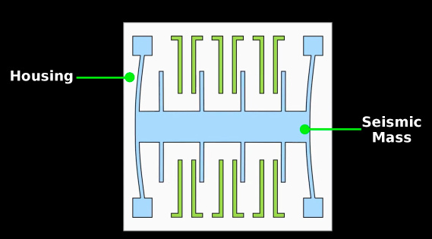
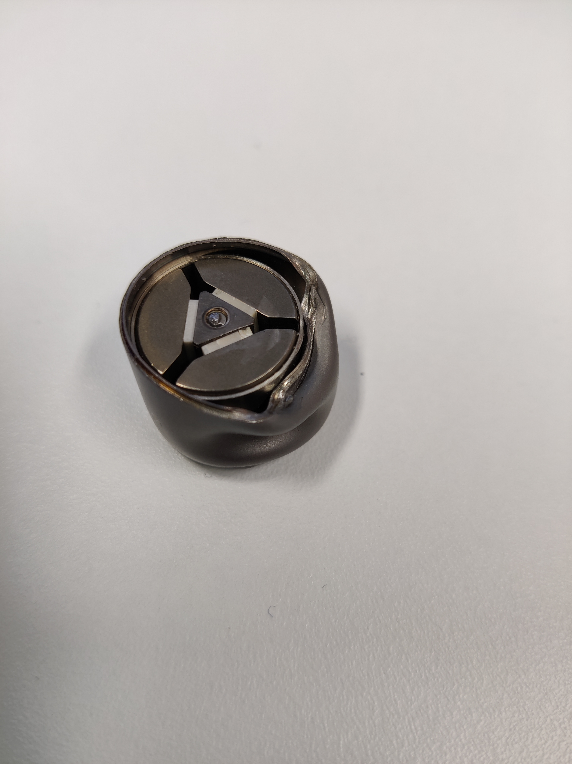
Acceleration sensors
http://en.wikipedia.org/wiki/Piezoelectric_accelerometer
Navigation, inclination, vibration, input devices, screen orientation
Based on
Piezoelectricity
Piezoresistivity
Capacitive sensing
1 housing, 2 preloading bolt, 3 piezoelectric elements, 4 seismic mass, and 5 electric connector.
http://www.leancrew.com/all-this/2012/05/accelerometers/
Notes:
Rotating machine condition monitoring. Measure rotation amplitude and frequency to determine bearing or gear faults before the machine breaks down.
Inclination reference Earth’s gravity (acceleration towards the center of the Earth)
Very high frequencies
Inclinometer
Seismic mass applies a force or changes relative position

Slide 26
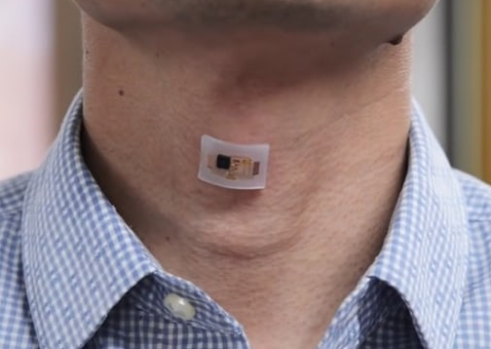
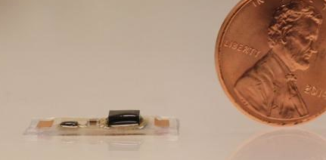
Example: wearable sensor
Accelerometer measures body vibrations
Heart rate
Voice
Lots of signal filtering
FFT etc.
http://newatlas.com/heart-acoustic-sensor-monitor/46506/

Slide 27
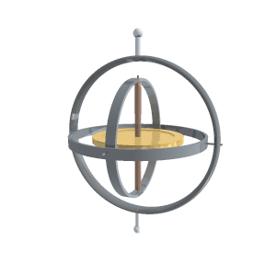
Gyroscope
http://www.sensorwiki.org/doku.php/sensors/gyroscope
Measures rate of angular rotation
Bias stability (drift), angle random walk, maximum rate of change
Navigation, platform stabilization
Principles
Mechanical – complex, expensive, very accurate
MEMS – low cost & power, often not very accurate (drift >10 deg/h)
Optical – accurate, medium cost, shock tolerant
Notes:
Measures angular velocity. No reference i.e. incremental.
Traditional version is a spinning mass in a gimball (frame) which allows the mass to rotate freely.
When torque is applied along one axis, because of conservation of angular momentum, torque is created along an axis perpendicular to the input and rotation axis.
Cell phones, robotics, stabilization, prosthetics
Consumer grade drift 30 to 1000 degrees per hour
Tactical 1-30 degrees/h
Navigation 0.01-0.1
Strategic <0.01 /hour
One or several degrees of freedom i.e. measurable directions of rotation.
https://en.wikipedia.org/wiki/Ring_laser_gyroscope

Slide 28
MEMS sensors

Slide 29
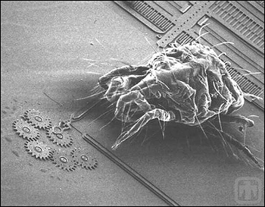
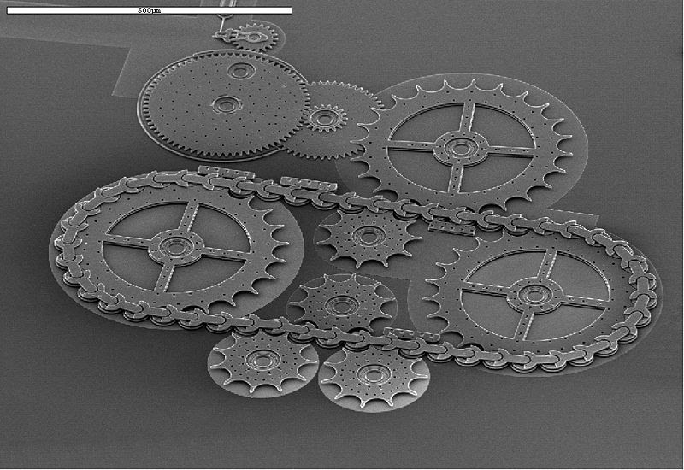
MEMS
https://www.maximintegrated.com/en/app-notes/index.mvp/id/5418
Microelectromechanical system
Part dimensions 1-100 µm
Low power
Produced like electronic circuits
Mass manufacturing -> cheap
http://rmmechanical.blogspot.fi/2010/11/micro-electro-mechanical-systems-mems.html
Notes:
Component size between 1 and 100 micrometers, system size maximum a couple of millimeters.
Produced with modified semiconductor manufacturing devices. Silicon wafers, masking, photolitography, etching , electroplating etc. Several devices
Images are black and white because taken with scanning electron microscope.

Slide 30
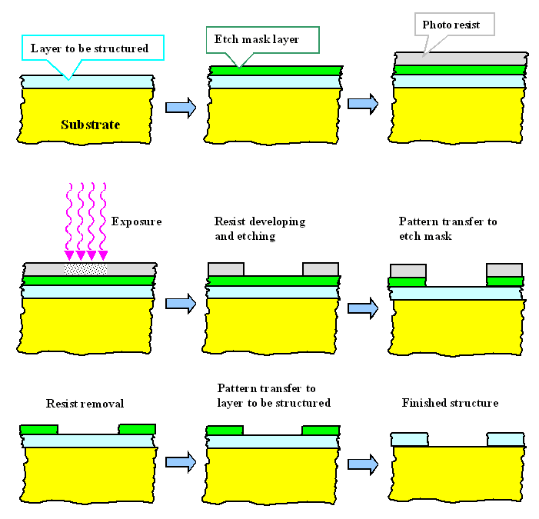
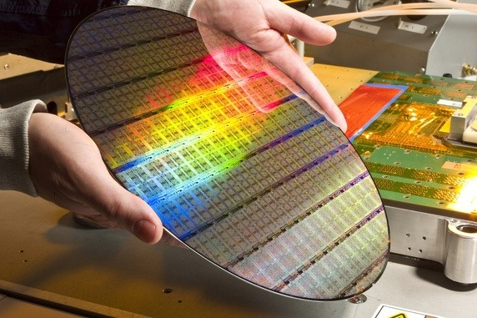
Photolithography
Deposit
Mask
Etch
Repeat
Dutch company ASML dominates
Notes:
Nice to know stuff.
One silicon wafer can contain hundreds (thousands?) of sensors

Slide 31
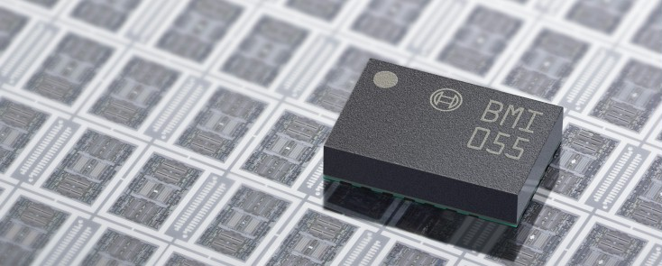
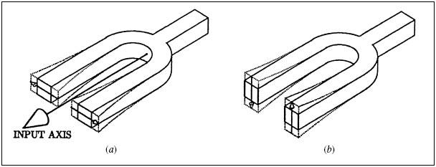
MEMS gyroscopes
http://www.bosch-sensortec.com/de/homepage/products_3/6_axis_sensors_2/inertial_measurement_unit_1/inertial_measurement_unit_2
Cheap, small, low power
Error sources
Bias error causes drift 1-1000°/h
Acceleration (vibration)
Tilting causes acceleration
Shocks
Exceeding range
http://www.memsjournal.com/2011/01/motion-sensing-in-the-iphone-4-mems-gyroscope.html
Notes:
Several different mass and excitation configurations. Usually excited with capacitive comb drives or piezoelectric materials.
Tuning fork gyroscope. Two masses vibrate along one axis, rotation causes Coriolis force which causes displacement along measuring axis. Capacitive detection.
Often include signal conditioning, amplification, filtering and calibration in the same package.
A fundamental problem with MEMS gyroscopes is that a gyroscope is based on mass and MEMS don’t have much of that.
Automotive: electronic stability control
Photography: image stabilization
https://en.wikipedia.org/wiki/Vibrating_structure_gyroscope
http://www.analog.com/en/technical-articles/gyro-mechanical-performance.html

Slide 32

MEMS acceleration sensor
Notes:
https://www.youtube.com/watch?v=9eSnxebfuxg

Slide 33
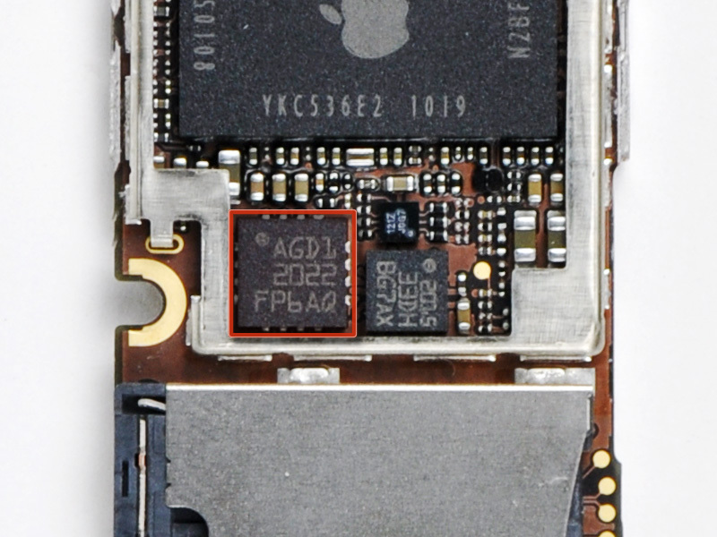
MEMS example: Iphone 4 gyroscope
https://www.ifixit.com/Teardown/iPhone+4+Gyroscope+Teardown/3156

Slide 34
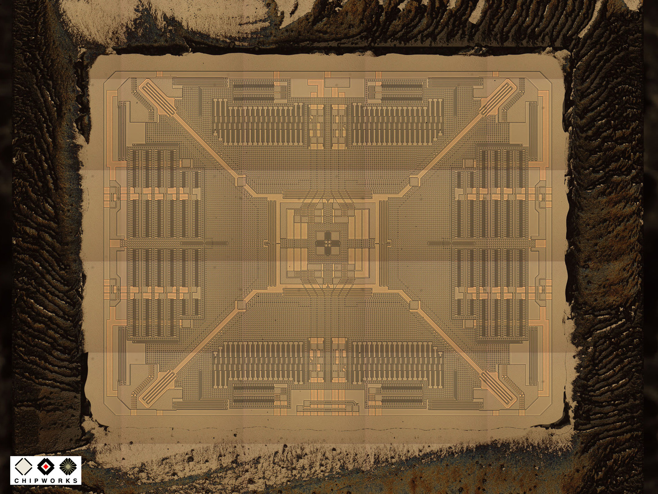
MEMS example: Iphone 4 gyroscope
https://www.ifixit.com/Teardown/iPhone+4+Gyroscope+Teardown/3156

Slide 35
http://www.memsjournal.com/2011/01/motion-sensing-in-the-iphone-4-mems-gyroscope.html
https://www.ifixit.com/Teardown/iPhone+4+Gyroscope+Teardown/3156

Slide 36

MEMS example: Iphone 4 gyroscope
http://www.memsjournal.com/2011/01/motion-sensing-in-the-iphone-4-mems-gyroscope.html

Slide 37
Sensor fusion

Slide 38


Inertial measurement unit (IMU)
2-11 degrees of freedom (DOF)
1-3 axis accelerometer
1-3 axis gyroscope
1-3 axis magnetometer
”Extra” sensors
Pressure (altitude from atmospheric pressure)
GPS
Sensor fusion
Notes:
6 DOF IMU starting 2.5 euros
10 DOF imu for 20 euros
with GPS ~80 euros

Slide 39

Sensor fusion
Combine several sensors to increase precision
http://www.edn.com/design/sensors/4402401/2/Motion-sensors-de-mystified

Slide 40

Kalman filter
Algorithm to get ”optimal” results from several sensors
Left: Accelerometer, Middle: Kalman fusion, Right: Gyroscope
Notes:
Recursive algorithm to combine the best properties of several information sources.
Uses a model of the system and information on uncertainties of the measurements.
Left: Accelerometer
Middle: Fusion
Right: Gyroscope
https://www.youtube.com/watch?v=MJ71V_wxtuU

Slide 41

Sensor fusion for positioning
Absolute measurement (GPS)
vs.
incremental (odometry)
Odometry= data from position sensors such as encoders in wheels and steering wheel

Slide 42
Summary
Everything that can be converted to voltage, current or charge can be measured
Absolute vs incremental sensors
MEMS sensors are cheap and getting more accurate
Sensor fusion

Slide 43
Misc.

Slide 44
Indirect measurements
Strain -> Pressure
Pressure ->Hydraulic force
Force -> Mass
Acceleration -> Position/velocity
Pressure -> Fluid velocity
Back emf voltage -> Motor speed
Notes:
https://en.wikipedia.org/wiki/Airspeed_indicator
Integrating acceleration to get velocity or position causes drift.
Often it is easier and cheaper to calculate a value from other measurements with a mathematical model than measure it directly

Slide 45
Other sensors
Electrical – voltage, current
Light – intensity, spectrum
Material concentration – pH, gas detectors etc.
Flow – air or liquid
Radiation – geiger counter
Acoustic
Notes:
Anything that can be converted to voltage can be measured.
Flow sensors often based on converting the flow to mechanical movement with for example gears.

Slide 46

Other sensors – civil engineering
Humidity
Temperature
Light intensity
Carbon dioxide
Air speed
Radiation
Smoke detector
Notes:
Energy saving and more comfortable buildings.
CO2 controlled ventilation. Ventilation controlled by true need.

